Slide 1
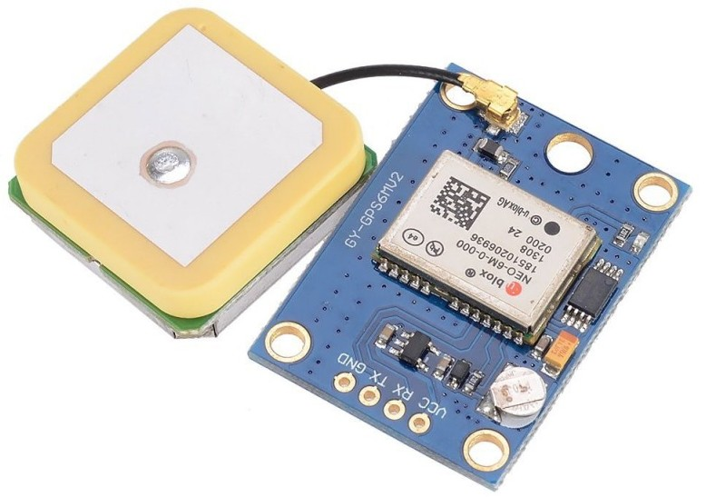
NEO-6M GPS Module
Utilizes its GPS input signal external antenna to receive the module's current position based on their longitude, latitude, and altitude through satellite positioning.
Helps pinpoint the user's exact location on Earth. It can be very useful for outdoor activities, like hiking or geocaching, or for navigating around harsh terrains.
In emergency situations, it will record the user's last known coordinates into the Micro SD storage when vital signs reach critical danger levels, such as an abnormal heart rate or toxic air quality.

Slide 2
NEO-6M GPS Module
Operating voltage: 2.7V ~ 5V
has a soldered 3.3V LDO regulator, which is a linear converter
Interfaces with UART
Operating temperature: -40℃ ~ 85℃
Cost: $8.99

Slide 3
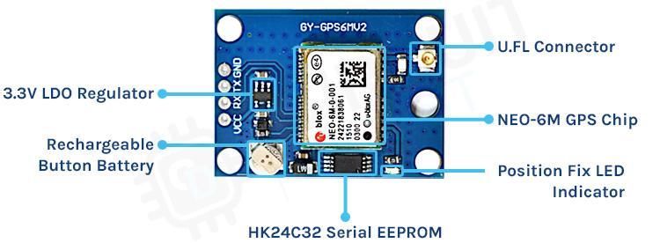
U.FL Connector
3.3V LDO Regulator
NEO-6M GPS Chip
Rechargeable
Button Battery
Position Fix LED
Indicator
24C32 Serial EEPROM

Slide 4
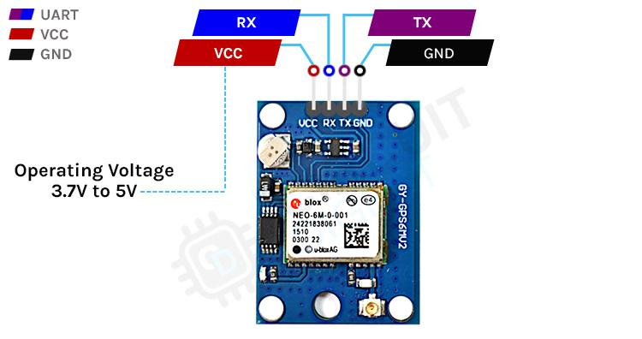
Operating Voltage
2.7V to 5V

